Slide 1
PROJECT INTRODUCTION

Slide 2
CONTENT
ABOUT THE PROJECT
PARTNERS
WORK ORGANIZATION
POWERSKIN+ CONCEPT
PROJECT OBJECTIVES & GOALS
DEMONSTRATION SITES
TIMELINE
CONTACTS

Slide 3
POWERSKIN+ PROJECT
Highly advanced modular integration of insulation, energizing and storage systems for non-residential buildings.
European Union research project under the topic LC-EEB-01-2019 - Integration of energy smart materials in non-residential buildings (IA).
START: October 1, 2019
DURATION: 48 months

Slide 4
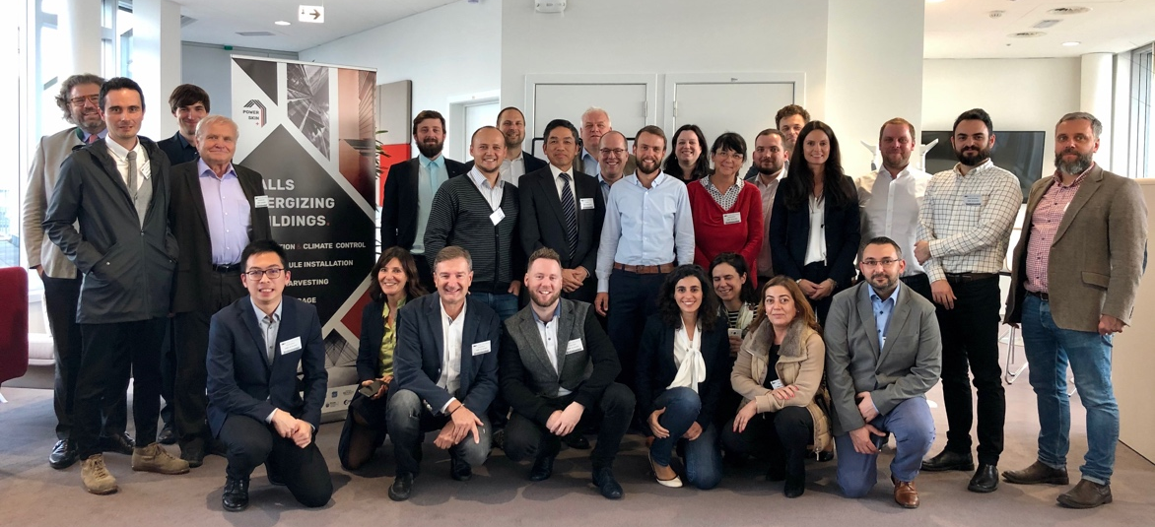




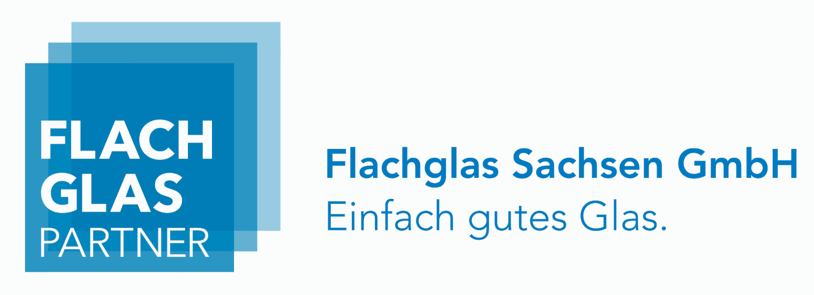









POWERSKIN+ PARTNERS
14 PARTNERS
9 COUNTRIES

Slide 5
POWERSKIN+ WORK ORGANIZATION
WP2
  Design and parametrization of energy smart materials and components
  FRAUNHOFER
WP1
WP9
WP3
  Materials for transparent module development
  FSU JENA
WP4
  Materials for opaque module development
  BUL
WP5
  System production and integration
  FGS
  Project management
  IPN
WP6
  Simulation, Characterization and Validation POLITO
  Dissemination, communication and exploitation
  FENIX TNT
WP7
  Environmental & economic analysis
  OBU
WP10
  Ethics requirements
  IPN
WP8
  Pilot demonstrations
  CVUT

Slide 6

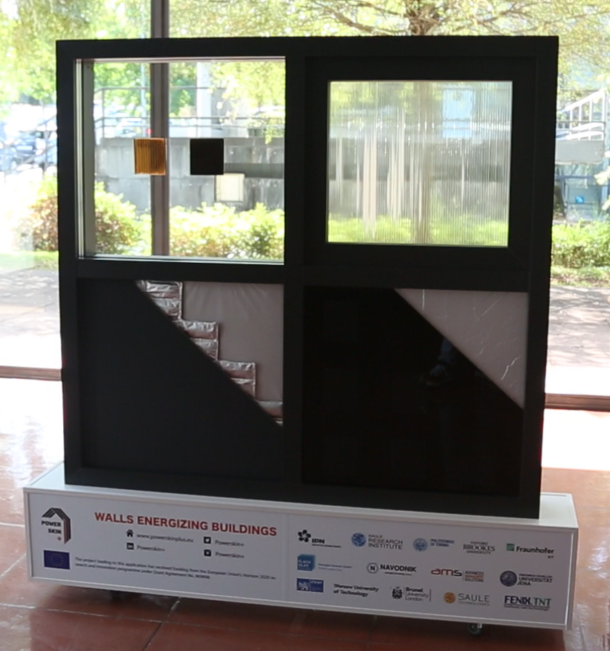

POWERSKIN+
Deliver innovative opaque and transparent modular façade solutions having a smart integration of super insulative elements, solar energy harvesting components and energy storage features, all in one combined and easy to install system.
Both standard (budget) and combined premium solutions
Different sets of add-ons to match specific needs:
geographical (climate) conditions
physical constraints
national regulations
refurbishment budgets

Slide 7
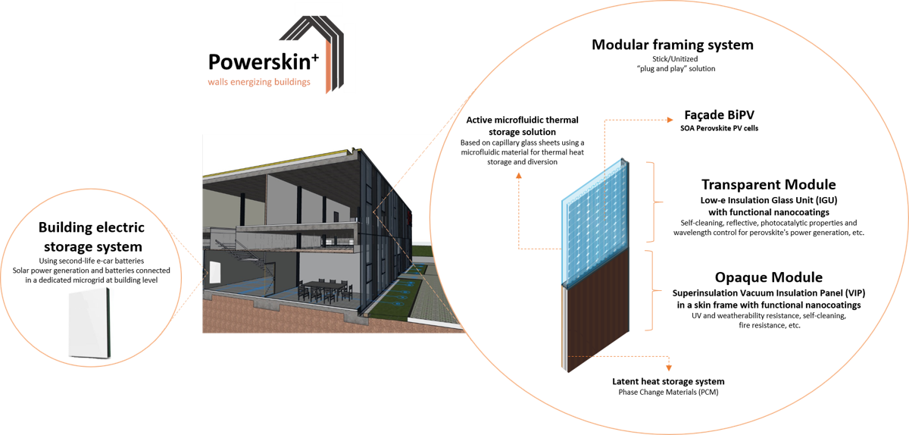
+ CONCEPT
New generation of off-site, prefabricated and easy-to-install integrated solutions for curtain wall systems
Combining a wide number of state-of-the-art high energy- efficient materials, systems and technologies KETs
Nano-superinsulation elements
Multi-functional nano-enabled coatings
Solar energy harvesting components based on flexible perovskite solar cells
Active/passive microfluidic thermal storage materials & PCM-driven latent heat storage elements
Second-life Li-ion batteries from hybrid and electrical vehicles

Slide 8

+ OBJECTIVES
Generate innovative hybrid-enabled systems enhanced with different multifunctional add-on features, for nZEB and Plus Energy Building Curtain Wall solutions
Demonstrate true holistic façade solutions in an operational environment, treading the path for future exploitation of non-residential buildings as the primary entrance market
Aim at new buildings but especially provide the retrofit market with highly adaptive multi-case energy efficient and management systems
Set POWERSKIN+ from lab to operational environment (TRL7)

Slide 9


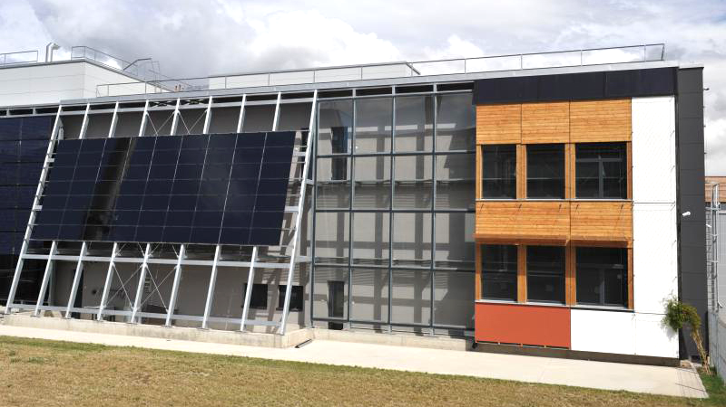

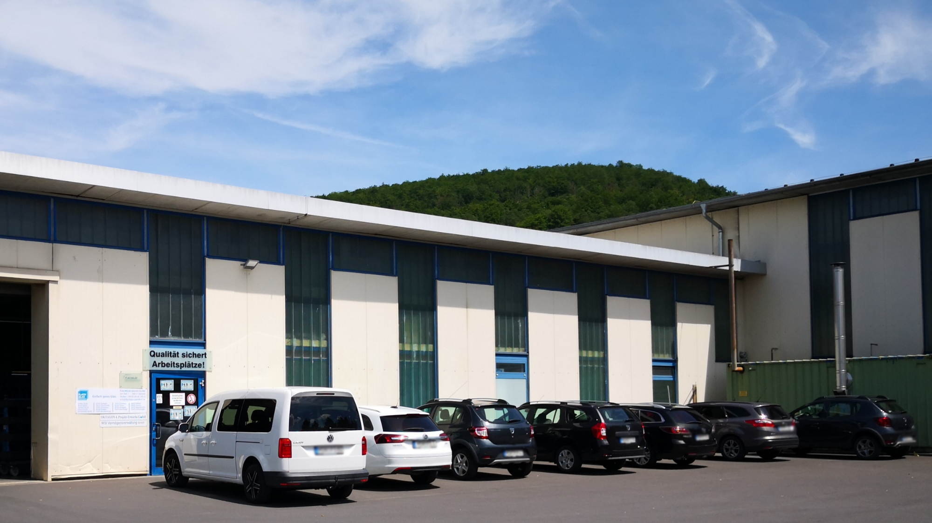

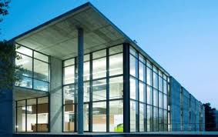
+ DEMONSTRATION
Prototyping and demonstration of both premium and affordable solutions
Operational environment in 3 real-size non-residential buildings located in 3 European countries (Portugal, Germany and the Czech Republic)

Slide 10
+ TIMELINE
OCT 2019
2020
2021
2022
SEP 2023
May 2021
POWERSKIN+ energy materials and integrated systems production and performance specifications
March 2022
POWERSKIN+ system add-on prototypes
March 2023
POWERSKIN+ prototype system integration and validation
September 2023
POWERSKIN + demonstration in operational environment
September 2021
POWERSKIN+ opaque, prototype module
September 2021
POWERSKIN+ transparent prototype module

Slide 11





+ FOLLOW US
www.powerskinplus.eu
Follow latest news on our website and social media profiles.
@Powerskin-plus
@Powerskinplus
@Powerskinplus
Powerskinplus project

Slide 12

THANK YOU FOR YOUR ATTENTION
Please visit our website
www.powerskinplus.eu
Contact us via e-mail
info@powerskinplus.eu
This project has received funding from the European Union’s Horizon 2020 research and innovation programme under grant agreement No 869898.

